Slide 1






React Presentation

Slide 2
AGENDA
Reactjs
Router
Flux

Slide 3
What is React?
React Is A JAVASCRIPT LIBRARY FOR BUILDING USER INTERFACES

Slide 4
What makes React different?
Components, not templates
Re-render on update
Virtual DOM (and events)
Reuseable

Slide 5
REACT JS
Components
<div>, <span>, <ActionButton>, <Counter>
Var MyComponent = React.createClass({
render: function(
return <span>Hello!</span>
);
});
React.render(<MyComponent />, document.getElementById('myDiv'));

Slide 6
REACT JS
Components
Every component has a state object and a props object
State
setState
getInitialState

Slide 7
REACT JS
Anatomy of a Component: Properties
<ActionButton text="Book flight“ onAction={someFunc} />
var ActionButton = React.createClass({
render: function() {
return(
<button class="ActionButton“ onClick={this.props.onAction}>
<span>>{this.props.text}</span>
</button>
);
}
});

Slide 8
REACT JS
Anatomy of a Component: State
<Counter initialCount={4}/>
var Counter = React.createClass({
getInitialState: function() {
return {count: this.props.initialCount};
},
addToCount: function(delta) {
this.setState({count: this.state.count + delta})
},
render: function() {
return (
<div> <h3>Count: {this.state.count}</h3>
<ActionButton text="+1" onAction={this.addToCount.bind(this, 1)} />
<ActionButton text="-1" onAction={this.addToCount.bind(this, -1)} />
</div>
);
}
});

Slide 9
REACT JS
var MyComponent = React.createClass({
render: function(){
return (
<h1>Hello, {this.props.name}!</h1>
);
}
});
React.render(<MyComponent name="Handsome" />, document.getElementById('myDiv'));

Slide 10
Component Lifecycle
Components have three main parts of their lifecycle:
Mounting: A component is being inserted into the DOM.
Updating: A component is being re-rendered to determine if the DOM should be updated.
Unmounting: A component is being removed from the DOM.

Slide 11
Component Lifecycle - Mounting
getInitialState(): object is invoked before a component is mounted. Stateful components should implement this and return the initial state data.
componentWillMount(): is invoked immediately before mounting occurs.
componentDidMount(): is invoked immediately after mounting occurs. Initialization that requires DOM nodes should go here.

Slide 12
Component Lifecycle - Updating
componentWillReceiveProps(object nextProps): is invoked when a mounted component receives new props.
shouldComponentUpdate(object nextProps, object nextState(): boolean is invoked when a component decides whether any changes warrant an update to the DOM.
componentWillUpdate(object nextProps, object nextState): is invoked immediately before updating occurs. You cannot call this.setState() here
componentDidUpdate(object prevProps, object prevState): is invoked immediately after updating occurs.

Slide 13
Component Lifecycle - Unmounting
componentWillUnmount():is invoked immediately before a component is unmounted and destroyed. Cleanup should go here.

Slide 14
React Router
A route configuration is basically a set of instructions that tell a router how to try to match the URL and what code to run when it does
render((
<Router history={history}>
<Route path="/" component={App}>
<IndexRoute component={Dashboard} />
<Route path="about" component={About} />
<Route path="inbox" component={Inbox}>
<Route path="/messages/:id" component={Message} />
<Redirect from="messages/:id" to="/messages/:id" />
</Route>
</Route>
</Router>
), document.body)

Slide 15
React Router - Lifecycle
<Route path="/" component={App}>
<IndexRoute component={Home}/>
<Route path="invoices/:invoiceId" component={Invoice}/>
<Route path="accounts/:accountId" component={Account}/>
</Route>
/
Component | Lifecycle Hooks called
App | componentDidMount
Home | componentDidMount
Invoice | N/A
Account | N/A

Slide 16
React Router - Lifecycle
<Route path="/" component={App}>
<IndexRoute component={Home}/>
<Route path="invoices/:invoiceId" component={Invoice}/>
<Route path="accounts/:accountId" component={Account}/>
</Route>
/invoices/123
Component | Lifecycle Hooks called
App | componentWillReceiveProps, componentDidUpdate
Home | componentWillUnmount
Invoice | componentDidMount
Account | N/A

Slide 17
React Router - Lifecycle
<Route path="/" component={App}>
<IndexRoute component={Home}/>
<Route path="invoices/:invoiceId" component={Invoice}/>
<Route path="accounts/:accountId" component={Account}/>
</Route>
/invoices/789
Component | Lifecycle Hooks called
App | componentWillReceiveProps, componentDidUpdate
Home | N/A
Invoice | componentWillReceiveProps, componentDidUpdate
Account | N/A

Slide 18
React Router - Lifecycle
<Route path="/" component={App}>
<IndexRoute component={Home}/>
<Route path="invoices/:invoiceId" component={Invoice}/>
<Route path="accounts/:accountId" component={Account}/>
</Route>
/accounts/123
Component | Lifecycle Hooks called
App | componentWillReceiveProps, componentDidUpdate
Home | N/A
Invoice | componentWillUnmount
Account | componentDidMount

Slide 19
FLUX
Flux is just an architecture, not a framework.
Actions – Helper methods that facilitate passing data to the Dispatcher
Dispatcher – Receives actions and broadcasts payloads to registered callbacks
Stores – Containers for application state & logic that have callbacks registered to the dispatcher
Controller Views – React Components that grab the state from Stores and pass it down via props to child components.

Slide 20
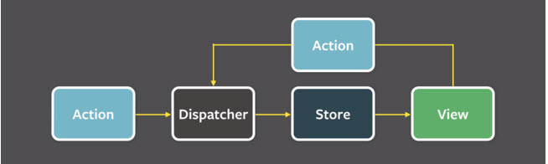
FLUX

Slide 21
FLUX - Dispatcher
The Dispatcher: The Dispatcher is basically the manager of this entire process
var Dispatcher = require('flux').Dispatcher;
var AppDispatcher = new Dispatcher();
AppDispatcher.handleViewAction = function(action) {
this.dispatch({
source: 'VIEW_ACTION',
action: action
});
}
module.exports = AppDispatcher;

Slide 22
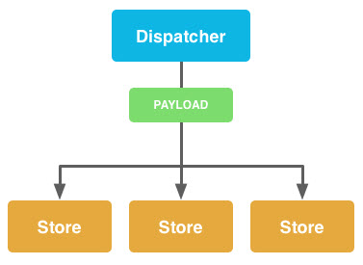
FLUX - Dispatcher
The Dispatcher

Slide 23
FLUX - Stores
Stores: Stores manage application state for a particular domain within your application. From a high level, this basically means that per app section, stores manage the data, data retrieval methods and dispatcher callbacks.

Slide 24
FLUX – Stores
function loadShoes(data) {
_shoes = data.shoes;
}
var ShoeStore = merge(EventEmitter.prototype, {
// Returns all shoes
getShoes: function() {
return _shoes;
},
emitChange: function() {
this.emit('change');
},
addChangeListener: function(callback) {
this.on('change', callback);
},
removeChangeListener: function(callback) {
this.removeListener('change', callback);
}
});

Slide 25
FLUX - Stores
// Register dispatcher callback
AppDispatcher.register(function(payload) {
var action = payload.action;
var text;
// Define what to do for certain actions
switch(action.actionType) {
case ShoeConstants.LOAD_SHOES:
// Call internal method based upon dispatched action
loadShoes(action.data);
break;
default:
return true;
}
// If action was acted upon, emit change event
ShoeStore.emitChange();
return true;
});

Slide 26
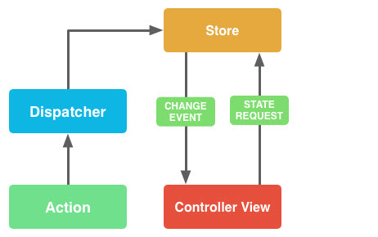
FLUX - Stores

Slide 27
FLUX - Actions
Action Creators are collections of methods that are called within views (or anywhere else for that matter) to send actions to the Dispatcher. Actions are the actual payloads that are delivered via the dispatcher
var ShoeStoreActions = {
loadShoes: function(data) {
AppDispatcher.handleAction({
actionType: ShoeStoreConstants.LOAD_SHOES,
data: data
})
}
};

Slide 28
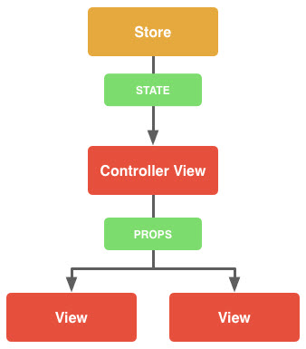
FLUX – Controller View
Controller views are really just React components that listen to change events and retrieve Application state from Stores. They then pass that data down to their child components via props.

Slide 29
FLUX – Controller View
function getAppState() {
return { shoes: ShoeStore.getShoes() };
}
var ShoeStoreApp = React.createClass({
// Use getAppState method to set initial state
getInitialState: function(){ return getAppState(); },
// Listen for changes
componentDidMount: function() { ShoeStore.addChangeListener(this._onChange); },
// Unbind change listener
componentWillUnmount: function() { ShoesStore.removeChangeListener(this._onChange);},
render: function() {
return ( <ShoeStore shoes={this.state.shoes} />);
},
// Update view state when change event is received
_onChange: function() { this.setState(getAppState());}
});

Slide 30
FLUX – Controller View
https://scotch.io/tutorials/getting-to-know-flux-the-react-js-architecture#stores

